Slide 1


Brain Signal Acquisition
Course S2022
Faculty: Dr Annushree Bablani

Slide 2
Background
The brain communicates using spikes-- produced when the neuron receives enough input current from other neurons via synaptic connections.
Recording brain activity are based on detecting changes in electrical potentials in neurons
invasive techniques based on implanting electrodes
Or on detecting changes in large populations of neurons
noninvasive techniques such as electroencephalography or EEG

Slide 3
Recording signals from brain
Invasive Approaches:
Techniques that allow recording from individual neurons in the brain are typically invasive.
They involve some form of surgery,
A part of the skull is removed, an electrode or implant placed in the brain, and the removed part of the skull then replaced.
A major advantage of invasive recordings is that they allow recording of action potentials at the millisecond timescale.

Slide 4
Invasive Approaches
Microelectrodes:
A microelectrode is simply a very fine wire or other electrical conductor used to make contact with brain tissue.
A typical electrode is made of tungsten or platinum- iridium alloy and is insulated except at the tip, which measures around 1μm in diameter (A neuron’s cell body diameter is in the range of tens of μm).

Slide 5
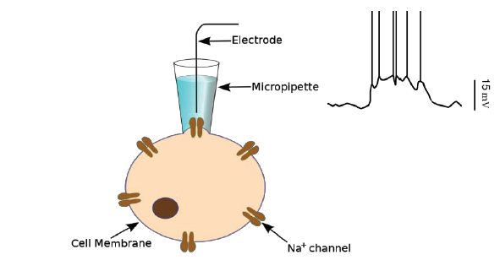
Invasive Approaches
Intracellular Recording:
Measures the voltage or current across the membrane of the neuron.
The most common technique, known as patch clamp recording.
Very Delicate → Intracellular recordings are typically performed only on slices of brain tissue

Slide 6
Invasive Approaches
Extracellular Recording:
Recording of a single neuron (or single“unit”): a tungsten or platinum-iridium microelectrode with a tip size of less than 10 microns is inserted into the target brain area.
The magnitude of the recorded signal is usually less than a millivolt and thus requires the use of amplifiers to detect the signal.
The signal from the amplifier is fed to a computer, which performs additional processing such as filtering noise and isolating the spikes (action potentials).

Slide 7
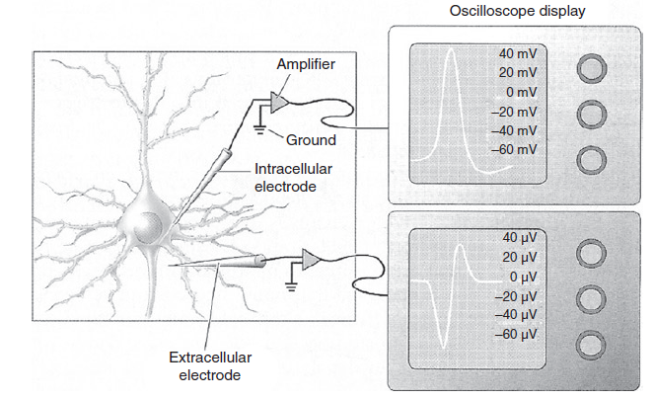
Invasive Approaches
(from Bear et al., 2007).

Slide 8
Invasive Approaches
When the neuron produces a spike, positive ions flow away from the extracellular electrode into the neuron, causing the initial negative deflection in the display. This is followed by a positive deflection as the action potential decreases and positive charges flow out of the neuron toward the extracellular electrode.

Slide 9
Invasive Approaches
Tetrodes and Multi-Unit Recording:
To record from multiple neurons simultaneously by using more than one electrode.
Four wires are tightly wound together in a bundle.

Slide 10
Invasive Approaches
Multielectrode Arrays:
To record from larger numbers of neurons, microelectrodes can be arranged in a grid-like structure to form a multielectrode array of m × n electrodes.
1.0 mm
(adapted from Hochberg et al., 2006).

Slide 11
Invasive Approaches
The most common types of implantable arrays are microwire, silicon-based, and flexible microelectrode arrays
Increased spatial resolution
The ability to record simultaneously from several dozens of neurons
Opens the door to extracting complex types of information such as position or velocity signals that could be useful for controlling prosthetic devices.

Slide 12
Partially Invasive Approach
Electrocorticography (ECoG):
Electrocorticography (ECoG) is a technique for recording brain signals that involves placing electrodes on the surface of the brain.
The procedure requires making a surgical incision into the skull to implant the electrodes on the brain surface

Slide 13
Partially Invasive Approach
ECoG electrodes can record the electrical fluctuations caused by the coherent activity of large populations of neurons (several tens of thousands).
Safer than arrays implanted inside the brain.
ECoG electrodes may also be less likely to wear out compared to brain penetrating electrodes
ECoG offers greater spatial resolution

Slide 14
(from (Miller et al., 2007).

Slide 15
Partially Invasive Approach
MicroECoG:
One disadvantage of ECoG, is the relatively large size of ECoG electrodes
These microelectrodes are only a fraction of a millimeter in diameter and spaced only 2–3 mm apart in a grid
Allows detection of neural activity at a much finer resolution than traditional ECoG.
Decoding fine movements, such as the movements of individual fingers, or even speech, without actually penetrating the brain.

Slide 16
Partially Invasive Approach
Optical Recording: Voltage-Sensitive Dyes and Two-Photon Calcium Imaging:
Voltage-sensitive dyes
Neurons are stained with a voltage-sensitive dye
Dye responds to changes in membrane potential by changing its absorption and/or fluorescence
Recorded optical signals correspond to summed responses from several simultaneously active neurons.
Useful for imaging macroscopic features of the brain such as feature maps in the cortex

Slide 17
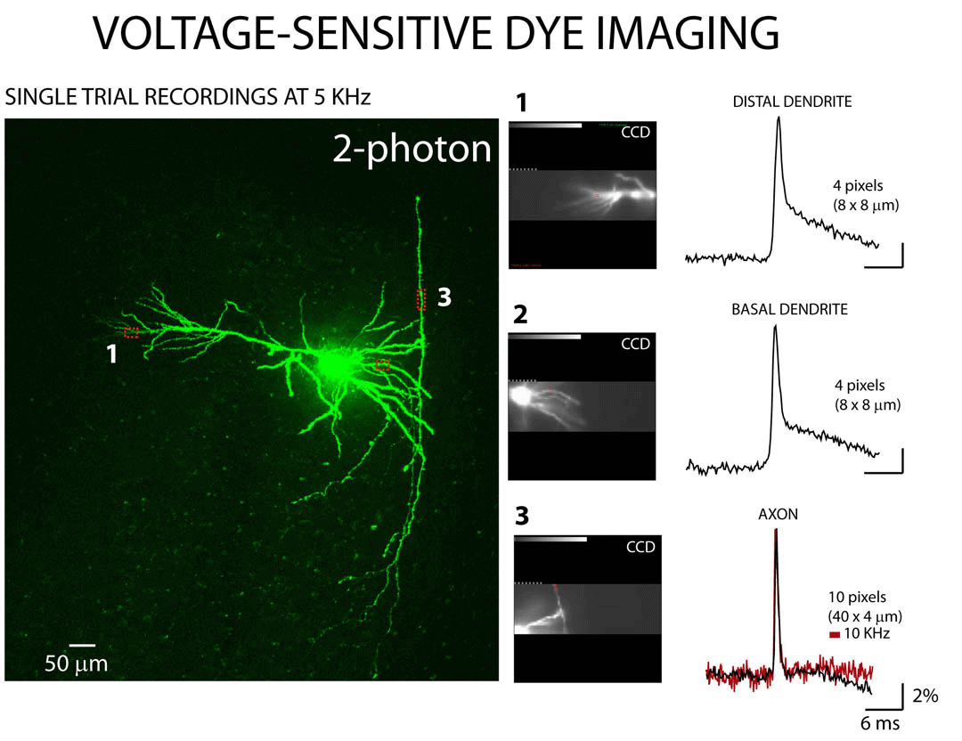
(image: Scholarpedia http://www.scholarpedia.org/article/Voltage-sensitive_dye).

Slide 18
Partially Invasive Approach
Two-photon calcium imaging
Based on the fact that electrical activity in neurons is typically associated with changes in calcium concentration.
Photon calcium imaging involves:
(1) using pressure ejection to load neurons with fluorescent calcium-indicator dyes
(2) monitoring changes in calcium fluorescence during neural activity using two-photon microscopy.

Slide 19
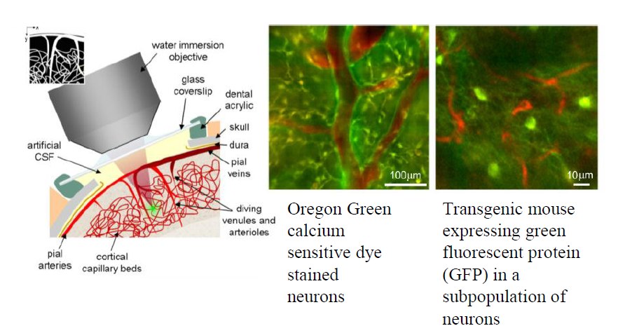
Image from Kherlopian et al., 2008).

Slide 20
Non Invasive Approaches
Electroencephalography (EEG)
EEG signals reflect the summation of postsynaptic potentials from many thousands of neurons that are oriented radially to the scalp.
EEG predominantly captures electrical activity in the cerebral cortex, whose columnar arrangement of neurons and proximity to the skull favor recording by EEG.

Slide 21
Non Invasive Approaches
Electroencephalography (EEG)
The spatial resolution is typically poor (in the square centimeter range)
Due to lots of muscles between the source of signal and the electrodes placed on the scalp.
The temporal resolution is good (in the milliseconds range)

Slide 22
Non Invasive Approaches
The measured signals are in the range of a few tens of microvolts, necessitating the use of powerful amplifiers and signal processing to amplify the signal and filter out noise.
Artifacts in the EEG signal
eye movements, eye blinks, eyebrow movements, talking, chewing, and head movements

Slide 23
Non Invasive Approaches
EEG recording involves the subject wearing a cap or a net into which the recording electrodes are placed
A conductive gel or paste is injected into the holes of the cap before placing the electrodes.
courtesy K. Miller

Slide 24
Non Invasive Approaches
The international 10–20 system is a convention used to specify standardized electrode locations on the scalp.
C = central, P = parietal, T = temporal, F = frontal, Fp = frontal polar, O = occipital, A = mastoids

Slide 26
The mastoids reference electrode locations behind each ear (A1 and A2).
Other reference electrode locations are nasion, at the top of the nose, level with the eyes; and inion, at the base of the skull on the midline at the back of the head.
In a typical setup, each EEG electrode is connected to one input of a differential amplifier, and the other input is connected to a reference electrode

Slide 27
The amplification of voltage between the active electrode and the reference is typically 1,000–100,000 times.
The amplified signal is passed through an filter and then digitized via an A/D (analog to digital) converter.
After digitization, the EEG signal may be additionally filtered by a 1–50 Hz bandpass filter.
Excludes noise and movement artifacts in the very low and very high frequency ranges.
Notes:
for instance, nasion or linked mastoids (average of the two mastoids).

Slide 28
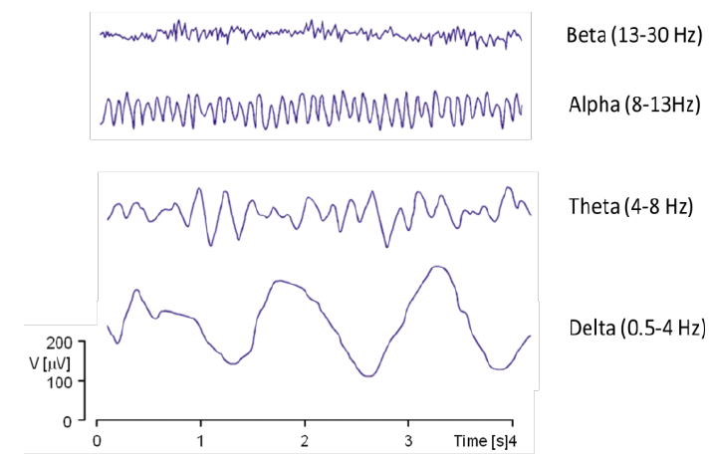
EEG recordings are well-suited to capturing oscillatory brain activity or “brain waves” at a variety of frequencies
Alpha waves (8 to 13 Hz)
Beta waves (13 to 30 Hz)
Delta waves (0.5-4 Hz)
Theta waves (4-8 Hz)
Gamma waves (30-100 Hz or more)
Notes:
for instance, nasion or linked mastoids (average of the two mastoids). An additional notch filter is typically used to remove “line noise” caused by the electrical power supply.

Slide 29
Non Invasive Approaches
Magnetoencephalography (MEG):
Measures magnetic fields produced by activity of thousands of cortical neurons oriented perpendicular to the cortical surface
Magnetic fields not distorted by skull and scalp
Better spatial resolution than EEG
Expensive and bulky
Magnetically shielded rooms

Slide 30
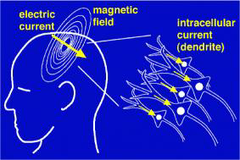
(image A: Wikimedia Commons;
image B: http://dateline.ucdavis.edu/photos_images/dateline_images/040309/DondersMEGOle_W2.jpg).

Slide 31
Non Invasive Approaches
Functional Magnetic Resonance Imaging (fMRI) :
Measures changes in blood flow due to increased activation of neurons in an area
Relies on paramagnetic properties of oxygenated and deoxygenated hemoglobin in the blood
Produces images showing blood-oxygenation-level-dependent signal changes (BOLD)

Slide 32
Example fMRI Images (word reading task)

Slide 33
Non Invasive Approaches
Functional Near-Infrared Spectroscopy (fNIR)
Measures change in blood oxygenation level caused by increased neural activity in the brain.
Based on detecting near-infrared light absorbance of hemoglobin in the blood with and without oxygen.
Maps neural activity using “optodes” (emitters and detectors)

Slide 35
Non Invasive Approaches
Positron Emission Tomography (PET):
Measures emissions from radioactively labeled, metabolically active chemicals that have been injected into the bloodstream for transportation to the brain.
The labeled compound is called a radiotracer.
Sensors in the PET scanner detect the radioactive compound
As a result of metabolic activity caused by brain activity.
Generate two-or three-dimensional images indicating the amount of brain activity.

Slide 36
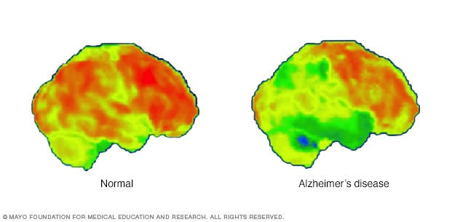
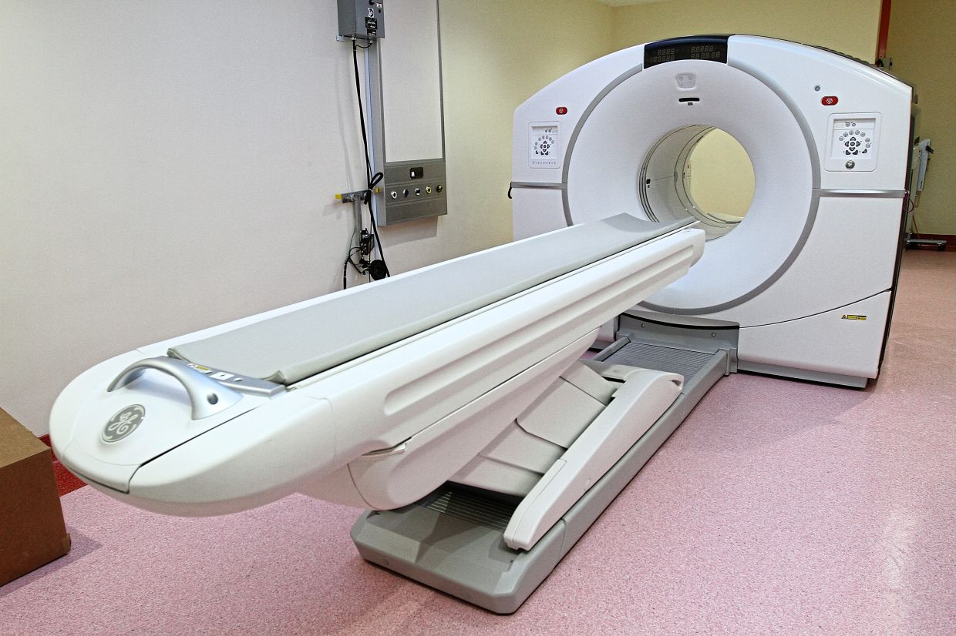
A PET scan can compare a normal brain (left) with one affected by Alzheimer's disease (right). An increase in blue and green colors shows decreased brain metabolic activity due to Alzheimer's disease.

Slide 37
Non Invasive Approaches
Single-photon emission-computed tomography (SPECT):
SPECT is a nuclear medicine technique that uses gamma rays to study the brain.
A radioactive substance is injected into the patient’s body and is scanned using a SPECT machine.
Allows doctors to see how blood flows into tissues and organs.
Active, inactive, or overactive.
Averages the brain activity over a few minutes and generates an image.

Slide 38
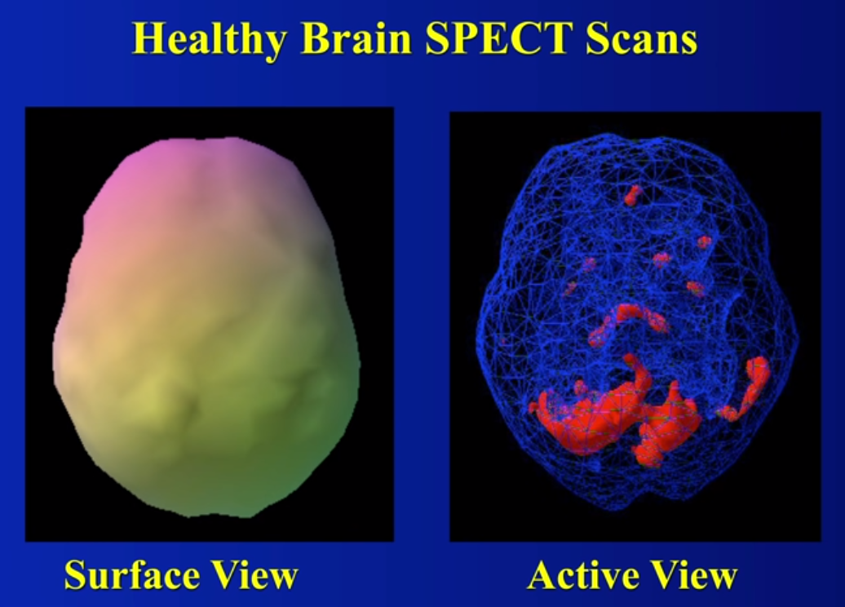
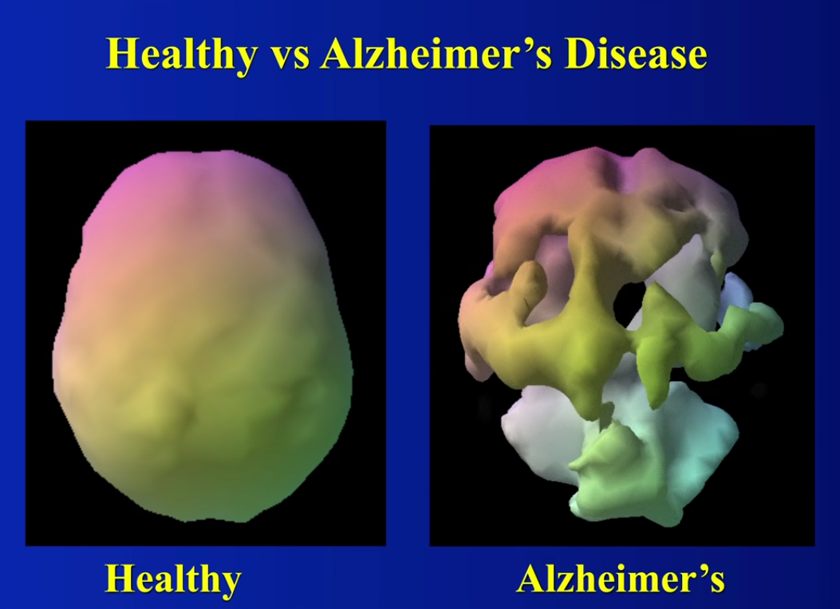
Image credit: https://hamnaqasim.medium.com/brain-scans-a-lesson-to-learn-9dfe67abd841

